Slide 1
Digital To Digital Conversion
Lecture-07-10
Chapter 04

Slide 2

Topics to be discussed
Digital to Digital Conversion
Data Elements Vs Signal Elements
Data Rate Vs Signal Rate
Line codding schemes
Block codding schemes
Scrambling

Slide 3
DIGITAL-TO-DIGITAL CONVERSION
In this section, we see how we can represent digital data by using digital signals.
The conversion involves three techniques: line coding, block coding, and scrambling.
Line coding is always needed; block coding and scrambling may or may not be needed.

Slide 4
Line Coding
Line coding is the process of converting digital data to digital signals.
The data can be, in the form of text, numbers, graphical images, audio, or video, which are stored in computer memory as sequences of bits.
Line coding converts a sequence of bits to a digital signal.
At the sender, digital data are encoded into a digital signal; at the receiver, the digital data are recreated by decoding the digital signal.

Slide 5
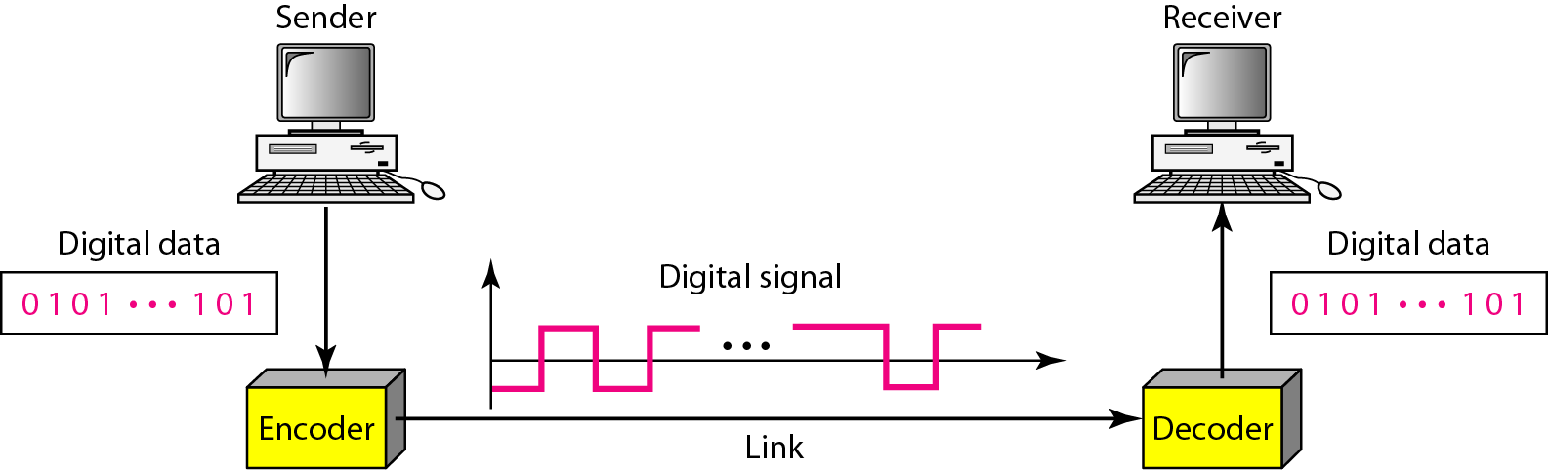
Figure 4.1 Line coding and decoding

Slide 6
Data Element Vs Signal element
A data element is the smallest entity that can represent a piece of information: this is the bit.
In digital data communications, a signal element carries data elements.
A signal element is the shortest unit (timewise) of a digital signal. In other words, data elements are what we need to send; signal elements are what we can send.
Data elements are being carried; signal elements are the carriers.
Example: Suppose each data element is a person who needs to be carried from one place to another then signal element is the vehicle.
r is a ratio that defines the number of data elements carried by each signal element.

Slide 7
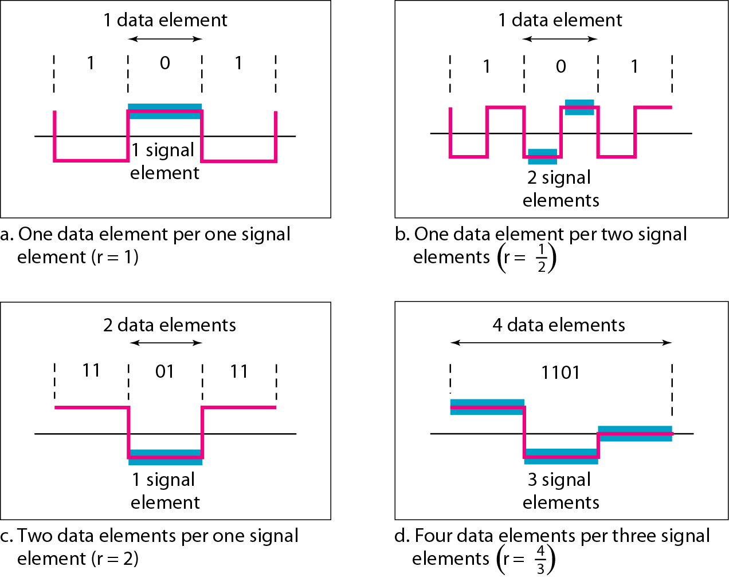
Figure 4.2 shows several situations with different values of r

Slide 8
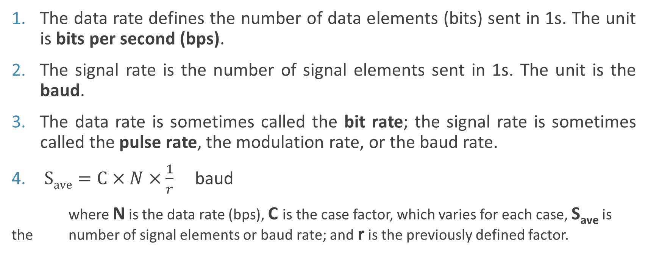
Data Rate Versus Signal Rate
The data rate defines the number of data elements (bits) sent in 1s. The unit is bits per second (bps).
The signal rate is the number of signal elements sent in 1s. The unit is the baud.
The data rate is sometimes called the bit rate; the signal rate is sometimes called the pulse rate, the modulation rate, or the baud rate.
$Save=C×N×\frac{1}{r}$ baud
where N is the data rate (bps), C is the case factor, which varies for each case, S_{ave} is the number of signal elements or baud rate; and r is the previously defined factor.

Slide 9
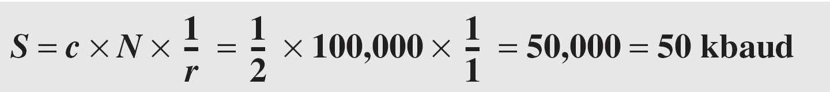
Example 4.1
A signal is carrying data in which one data element is encoded as one signal element ( r = 1). If the bit rate is 100 kbps, what is the average value of the baud rate if c is between 0 and 1?
Solution
We assume that the average value of c is 1/2 . The baud rate is then

Slide 10
Although the actual bandwidth of a digital signal is infinite, the effective bandwidth is finite.

Slide 11
The minimum bandwidth can be given as:
Bmin = c × N × (1 / r)
Maximum data rate if the bandwidth of the channel is given as:
Nmax = (1 / c) × B × r

Slide 12
Example 4.2
The maximum data rate of a channel (see Chapter 3) is Nmax = 2 × B × log₂ L (defined by the Nyquist formula). Does this agree with the previous formula for N_{max}?
Solution
A signal with L levels actually can carry log₂L bits per level. If each level corresponds to one signal element and we assume the average case (c = 1/2), then we have

Slide 13
Baseline Wandering:
In decoding a digital signal, the receiver calculates a running average of the received signal power. This average is called the baseline.
The incoming signal power is evaluated against this baseline to determine the value of the data element.
A long string of 0s or 1s can cause a drift in the baseline (baseline wandering) and make it difficult for the receiver to decode correctly.
A good line coding scheme needs to prevent baseline wandering.
DC Components:
When the voltage level in a digital signal is constant for a while, the spectrum creates very low frequencies (results of Fourier analysis).
These frequencies around zero, called DC (direct-current) components, present problems for a system that cannot pass low frequencies or a system that uses electrical coupling (via a transformer).
We can say that DC component means 0/1 parity that can cause base-line wondering.

Slide 14
Self-synchronization:
To correctly interpret the signals received from the sender, the receiver’s bit intervals must correspond exactly to the sender’s bit intervals.
If the receiver clock is faster or slower, the bit intervals are not matched and the receiver might misinterpret the signals.
Figure 4.3 shows a situation in which the receiver has a shorter bit duration.
The sender sends 10110001, while the receiver receives 110111000011.
A self-synchronizing digital signal includes timing information in the data which is being transmitted.
This can be achieved if there are transitions in the signal that alert the receiver to the beginning, middle, or end of the pulse.
If the receiver’s clock is out of synchronization, these points can reset the clock.

Slide 15
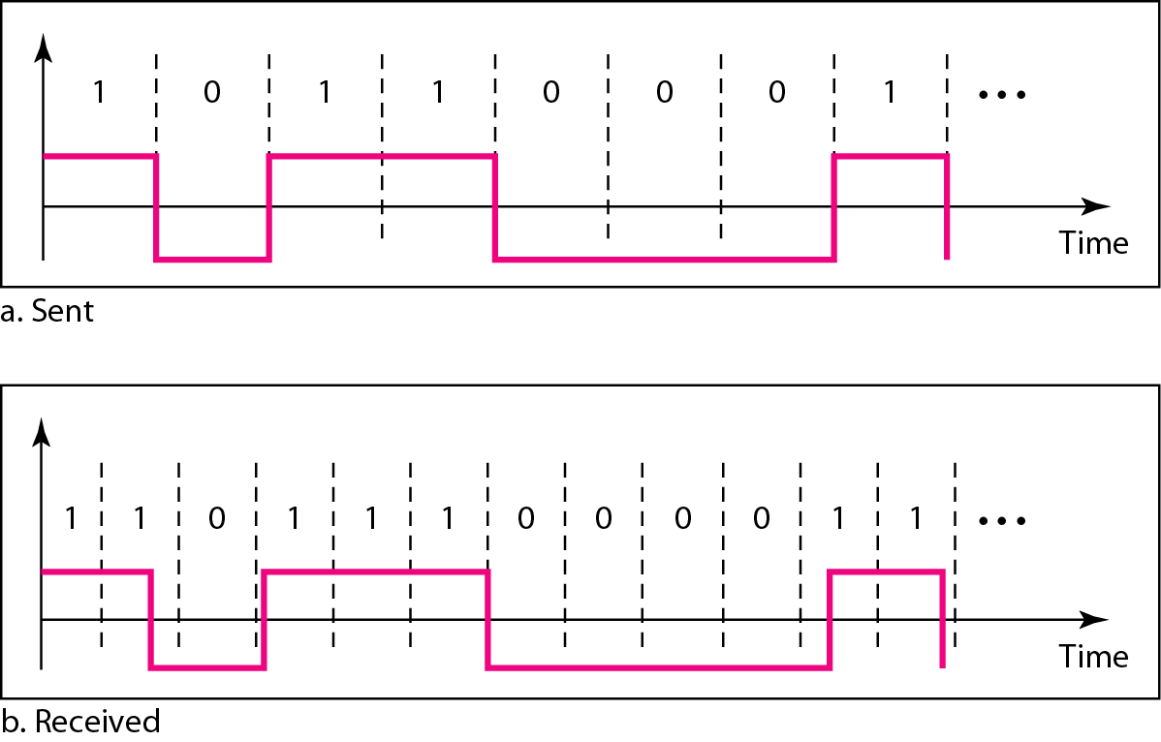
Figure 4.3 Effect of lack of synchronization

Slide 16
Example 4.3
In a digital transmission, the receiver clock is 0.1 percent faster than the sender clock. How many extra bits per second does the receiver receive if the data rate is 1 kbps? How many if the data rate is 1 Mbps?
Solution
At 1 kbps, the receiver receives 1001 bps instead of 1000 bps.
At 1 Mbps, the receiver receives 1,001,000 bps instead of 1,000,000 bps.

Slide 17
Built-in Error Detection:
It is desirable to have a built-in error-detecting capability in the generated code to detect some or all of the errors that occurred during transmission.
Immunity to Noise and Interference:
Another desirable code characteristic is a code that is immune to noise and other interferences.
Complexity:
A complex scheme is more costly to implement than a simple one. For example, a scheme that uses four signal levels is more difficult to interpret than one that uses only two levels.

Slide 18
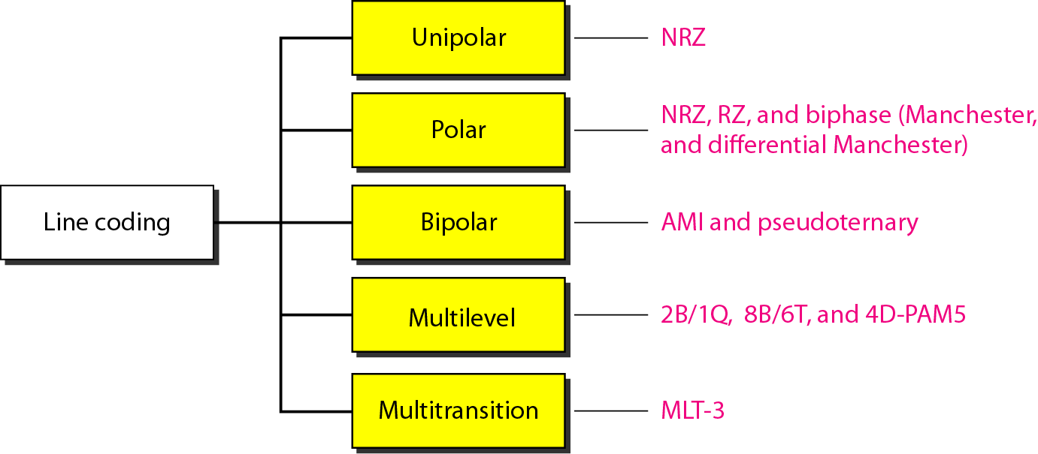
Figure 4.4 Line coding schemes

Slide 19
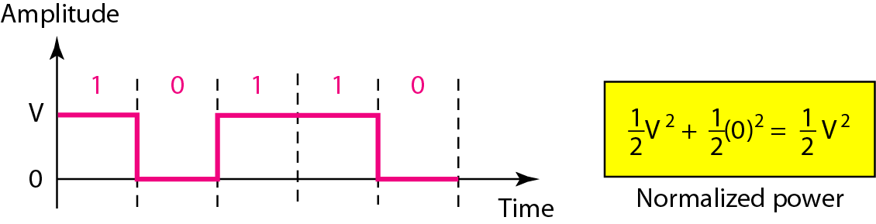
NRZ (Non-Return-to-Zero)
Traditionally, a unipolar scheme was designed as a non-return-to-zero (NRZ) scheme in which the positive voltage defines bit 1 and the zero voltage defines bit 0. It is called NRZ because the signal does not return to zero at the middle of the bit. Due to high power requirements this is not in use today.
Figure 4.5 Unipolar NRZ scheme

Slide 20
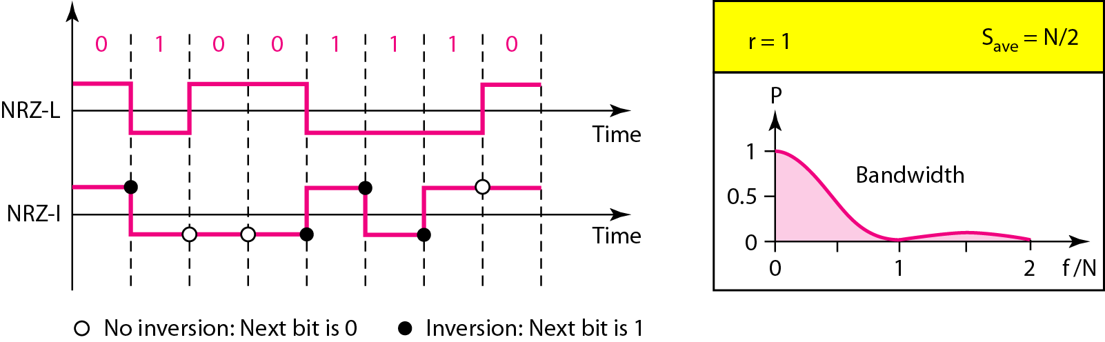
Non-Return-to-Zero (NRZ)
In polar NRZ encoding, we use two levels of voltage amplitude. In the first variation, NRZ-L (NRZ-Level), the level of the voltage determines the value of the bit.
In the second variation, NRZ-I (NRZ-Invert), the change or lack of change in the level of the voltage determines the value of the bit. If there is no change, the bit is 0; if there is a change, the bit is 1.
Figure 4.6 Polar NRZ-L and NRZ-I schemes

Slide 21
Problems with NRZ-L
Baseline wondering is more severe
Synchronization issues are more severe
Change in polarity
Problems with NRZ-I
Baseline wondering less severe
Synchronization issues are less severe

Slide 22

Note
In NRZ-L the level of the voltage determines the value of the bit. In NRZ-I the inversion or the lack of inversion determines the value of the bit.

Slide 23
Note
NRZ-L and NRZ-I both have an average signal rate of N/2 Bd.

Slide 24
Note
NRZ-L and NRZ-I both have a DC component problem.

Slide 25
Example 4.4
A system is using NRZ-I to transfer 10-Mbps data. What are the average signal rate and minimum bandwidth?
Solution
The average signal rate is S = N/2 = 500 kbaud. The minimum bandwidth for this average baud rate is Bmin = S = 500 kHz.

Slide 26
Return-to-Zero(RZ):
This scheme uses three values: positive, negative, and zero.
In RZ, the signal changes not between bits but during the bit. In Figure 4.7 we see that the signal goes to 0 in the middle of each bit. It remains there until the beginning of the next bit.
The main disadvantage of RZ encoding is that it requires two signal changes to encode a bit and therefore occupies greater bandwidth.
Polarity problem: a sudden change of polarity resulting in all 0s interpreted as 1s and all 1s interpreted as 0s, still exists here, but there is no DC component problem.
Complexity: RZ uses three levels of voltage, which is more complex to create and discern. As a result of all these deficiencies, the scheme is not used today.
Instead, it has been replaced by the better-performing Manchester and differential Manchester schemes (discussed next).

Slide 27
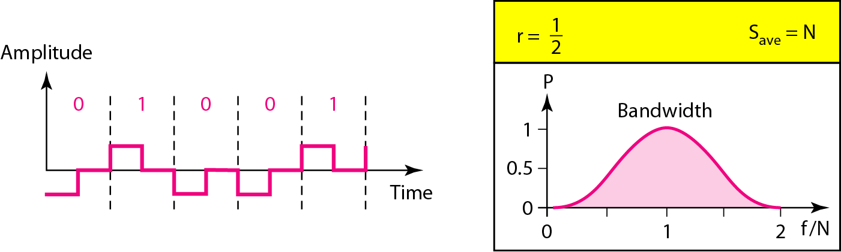
Figure 4.7 Polar RZ scheme

Slide 28
Manchester and Differential Manchester:
Manchester scheme combines the idea of RZ (transition at the middle of the bit) and the idea of NRZ-L. Here, the duration of the bit is divided into two halves. The voltage remains at one level during the first half and moves to the other level in the second half.
The transition at the middle of the bit provides synchronization.
Differential Manchester, on the other hand, combines the ideas of RZ and NRZ-I. There is always a transition at the middle of the bit, but the bit values are determined at the beginning of the bit.
If the next bit is 0, there is a transition; if the next bit is 1, there is none. Figure 4.8 shows both Manchester and differential Manchester encoding.

Slide 29
The Manchester scheme overcomes several problems associated with NRZ-L, and differential Manchester overcomes several problems associated with NRZ-I.
First, there is no baseline wandering. There is no DC component because each bit has a positive and negative voltage contribution.
The only drawback is the signal rate. The signal rate for Manchester and differential Manchester is double that for NRZ. The reason is that there is always one transition at the middle of the bit and maybe one transition at the end of each bit. Note that Manchester and differential Manchester schemes are also called biphase schemes.

Slide 30
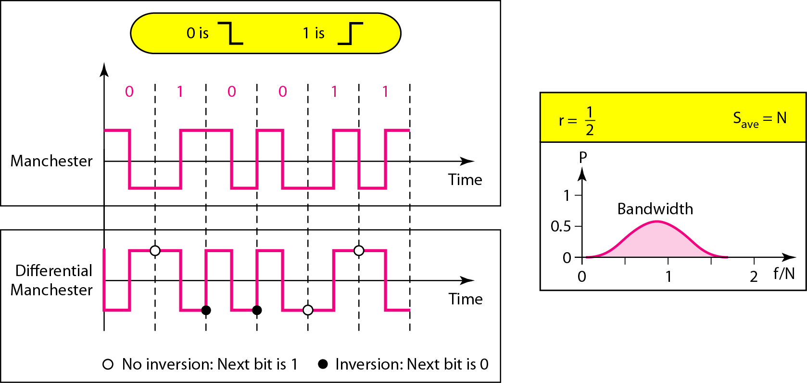
Figure 4.8 Polar biphase: Manchester and differential Manchester schemes

Slide 31
Note
In Manchester and differential Manchester encoding, the transition at the middle of the bit is used for synchronization.
The minimum bandwidth of Manchester and differential Manchester is 2 times that of NRZ.

Slide 32
Note
In bipolar encoding, we use three levels: positive, zero, and negative.

Slide 33
AMI and Pseudoternary:
Alternate Mark Inversion (AMI) is a bipolar codding scheme. In the term alternate mark (1 in telegraphy) inversion.
So AMI means alternate 1 inversion. A neutral zero voltage represents binary 0. Binary 1s are represented by alternating positive and negative voltages.
Pseudoternary is a variation of AMI encoding in which the 1 bit is encoded as a zero voltage and the 0 bit is encoded as alternating positive and negative voltages.
Advantages:
If we have a long sequence of 1s, the voltage level alternates between positive and negative; it is not constant. Therefore, there is no DC component.
AMI is commonly used for long-distance communication, but it has a synchronization problem when a long sequence of 0s is present in the data.

Slide 34
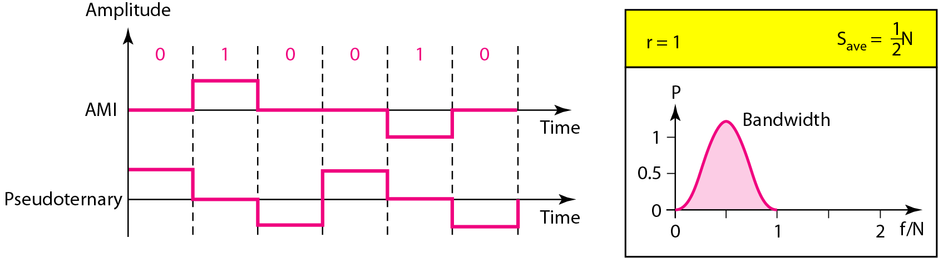
Figure 4.9 Bipolar schemes: AMI and pseudoternary

Slide 35
mBnL schemes
What Does mBnL Stand For?
• m: Number of binary data bits grouped together.
• B: Indicates binary data (each bit is 0 or 1).
• n: Number of signal elements used to represent the m-bit group.
• L: Number of signal levels (voltage or amplitude levels).
So, in an mBnL scheme, a group of m binary bits is encoded as n signal elements, each of which can take on L distinct levels.
1. 2B1Q (2 Binary, 1 Quaternary)
2. 8B6T (8 Binary, 6 Ternary)
3. 4B3T (8 Binary, 6 Ternary)

Slide 36
Advantages
- Bandwidth Efficiency: Fewer signal elements per bit.
- DC Balance: Easier to design codes with no DC component.
- Error Detection: Redundant signal patterns can be used for error checking.
Practical Use
These schemes are common in high-speed digital communication systems like:
- DSL (Digital Subscriber Line)
- Ethernet (e.g., 100BASE-T4)
- Optical and serial transmission standards

Slide 37
In mBnL schemes, a pattern of m data elements is encoded as a pattern of n signal elements in which 2^{m} ≤ L^{n}.
where m is the length of the binary pattern, B means binary data, n is the length of the signal pattern, and L is the number of levels in the signaling.
A letter is often used in place of L: B (binary) for L = 2, T (ternary) for L = 3, and Q (quaternary) for L = 4.
Note that the first two letters define the data pattern, and the second two define the signal pattern.

Slide 38
2B1Q:
The mBnL scheme is read as two binary, one quaternary (2B1Q), uses data patterns of size 2 and encodes the 2-bit patterns as one signal element belonging to a four-level signal.
In this type of encoding m = 2, n = 1, and L = 4 (quaternary).
Figure 4.10 shows an example of a 2B1Q signal.
The average signal rate of 2B1Q is S = N/4, i.e. we can send data 2 times faster than NRZ-L.
The 2B1Q scheme is used in DSL (Digital Subscriber Line) technology to provide a high-speed connection to the Internet by using subscriber telephone lines

Slide 39
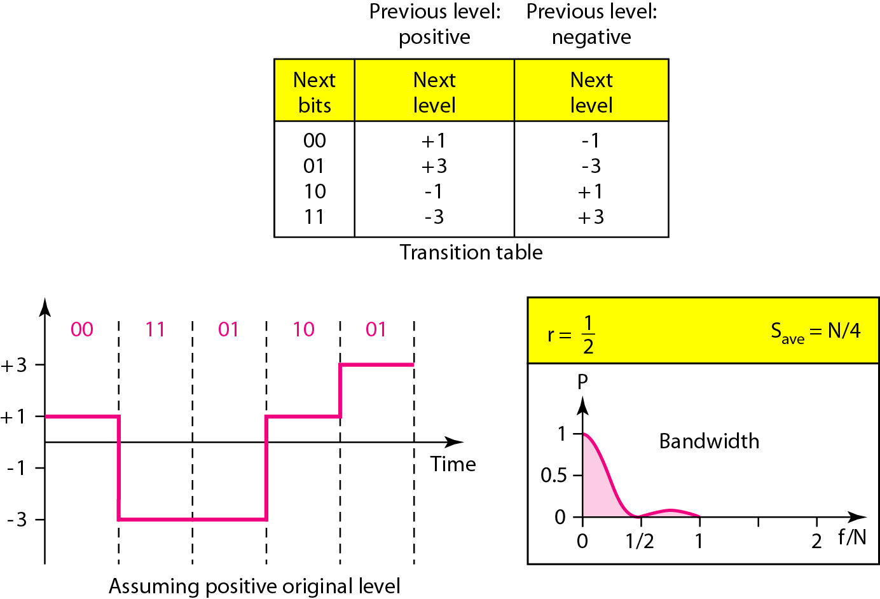
Figure 4.10 Multilevel: 2B1Q scheme

Slide 40
8B6T
Here we encode a pattern of 8 bits as a pattern of six signal elements, where the signal has three levels (ternary).
In this type of scheme, we can have 2⁸ = 256 different data patterns and 3⁶ = 729 different signal patterns.
There are 729 − 256 = 473 redundant signal elements that provide synchronization and error detection.
Part of the redundancy is also used to provide DC balance. Each signal pattern has a weight of 0 or +1 DC values. This means that there is no pattern with the weight −1.
To make the whole stream DC-balanced, the sender keeps track of the weight. If two groups of weight 1 are encountered one after another, the first one is sent as is, while the next one is totally inverted to give a weight of −1.
This code is used with 100BASE-4T cable.

Slide 41
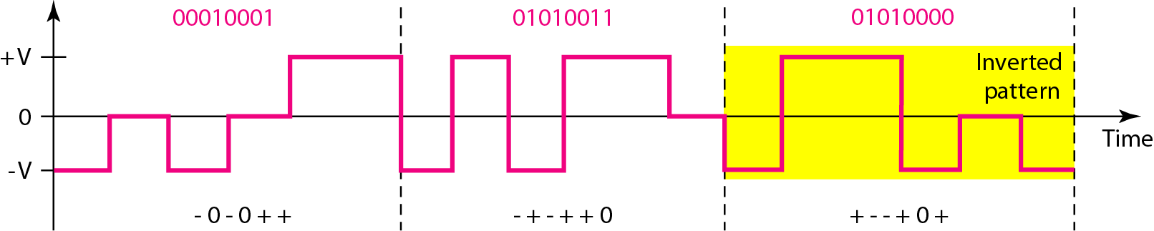
Figure 4.11 Multilevel: 8B6T scheme
The average signal rate of the scheme is theoretically Save = × N × ; in practice the minimum bandwidth is very close to 6N/8.

Slide 42
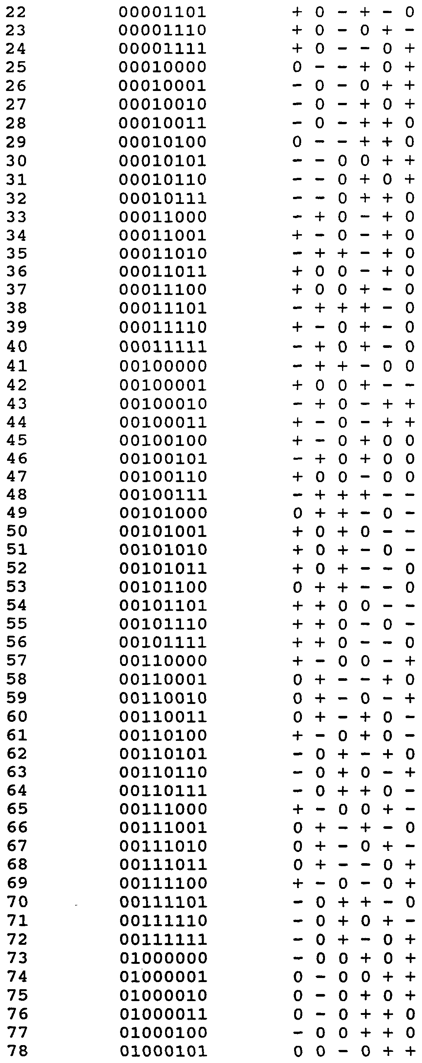

Slide 43
4D-PAM5
The full form of 4D-PAM5 is four-dimensional five level pulse amplitude modulation.
The 4D means that data is sent over four wires at the same time. It uses five voltage levels, such as −2, −1, 0, 1, and 2.
However, one level, level 0, is used only for forward error detection (discussed in Chapter 10). If we
assume that the code is just one-dimensional, the four levels create something similar to 8B4Q.
In other words, an 8-bit word is translated to a signal element of four different levels.
The technique is designed to send data over four channels (four wires) due to which the signal rate can be reduced to N/8, a significant achievement.
Gigabit LANs (see Chapter 13) use this technique to send 1-Gbps data over four copper cables that can handle 125 Mbaud.
This scheme has a lot of redundancy in the signal pattern because 2⁸ data patterns are matched to 4⁴ = 256 signal patterns. The extra signal patterns can be used for other purposes such as error detection.

Slide 44
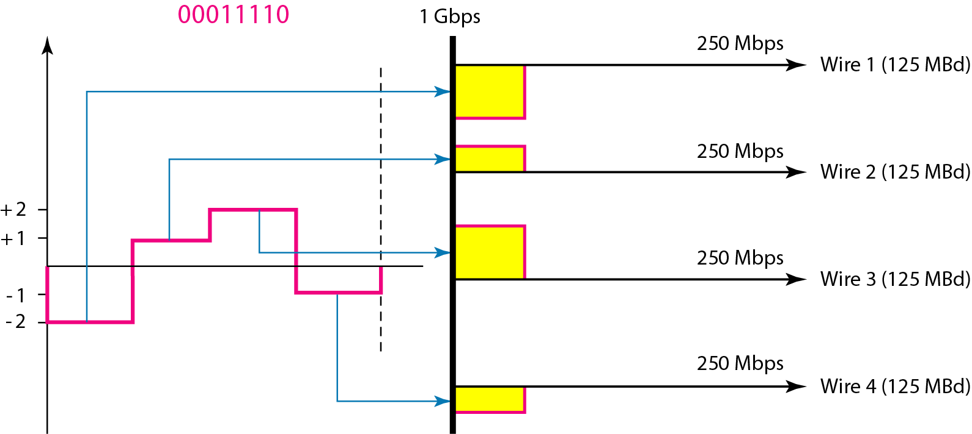
Figure 4.12 Multilevel: 4D-PAM5 scheme

Slide 45
MLT-3:
The multiline transmission, three-level (MLT-3) scheme uses three levels (+V, 0, and −V) and three transition rules to move between the levels.
1. If the next bit is 0, there is no transition.
2. If the next bit is 1 and the current level is not 0, the next level is 0.
3. If the next bit is 1 and the current level is 0, the next level is the opposite of the last nonzero level.
2. In the Figure 3.14(c), the three voltage levels (−V, 0, and +V) are shown by three states (ovals). The transition from one state (level) to another is shown by the connecting lines.
3. The signal rate is the same as that for NRZ-I, but the shape of the signal in this scheme helps to reduce the required bandwidth.
4. Let us look at the worst-case scenario, a sequence of 1s. In this case, the signal element pattern +V 0 −V 0 is repeated every 4 bits. A nonperiodic signal has changed to a periodic signal with the period equal to 4 times the bit duration.
5. This worst-case situation can be simulated as an analog signal with a frequency one- fourth of the bit rate. In other words, the signal rate for MLT-3 is one-fourth the bit rate. This makes MLT-3 a suitable choice when we need to send 100 Mbps on a copper wire that cannot support more than 32 MHz (frequencies above this level create electromagnetic emissions).

Slide 46
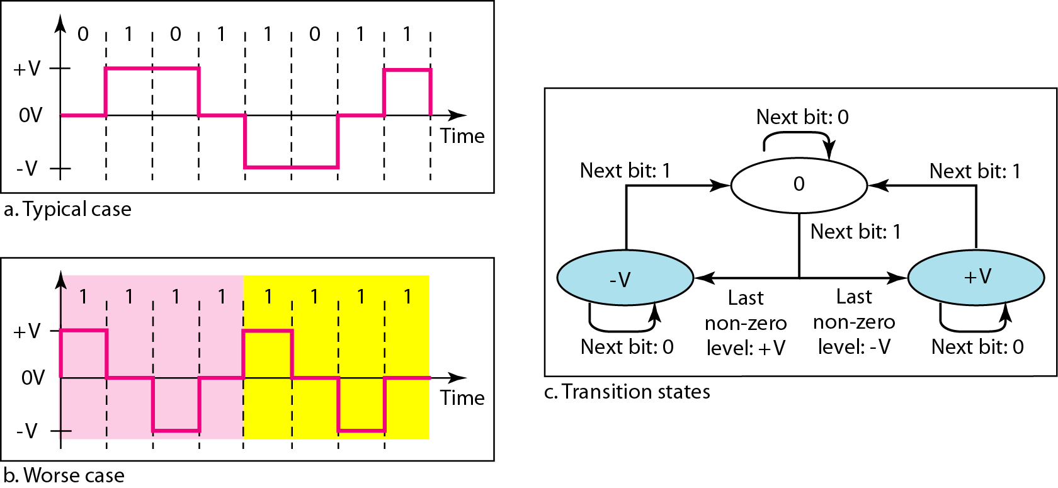
Figure 4.13 Multitransition: MLT-3 scheme

Slide 47
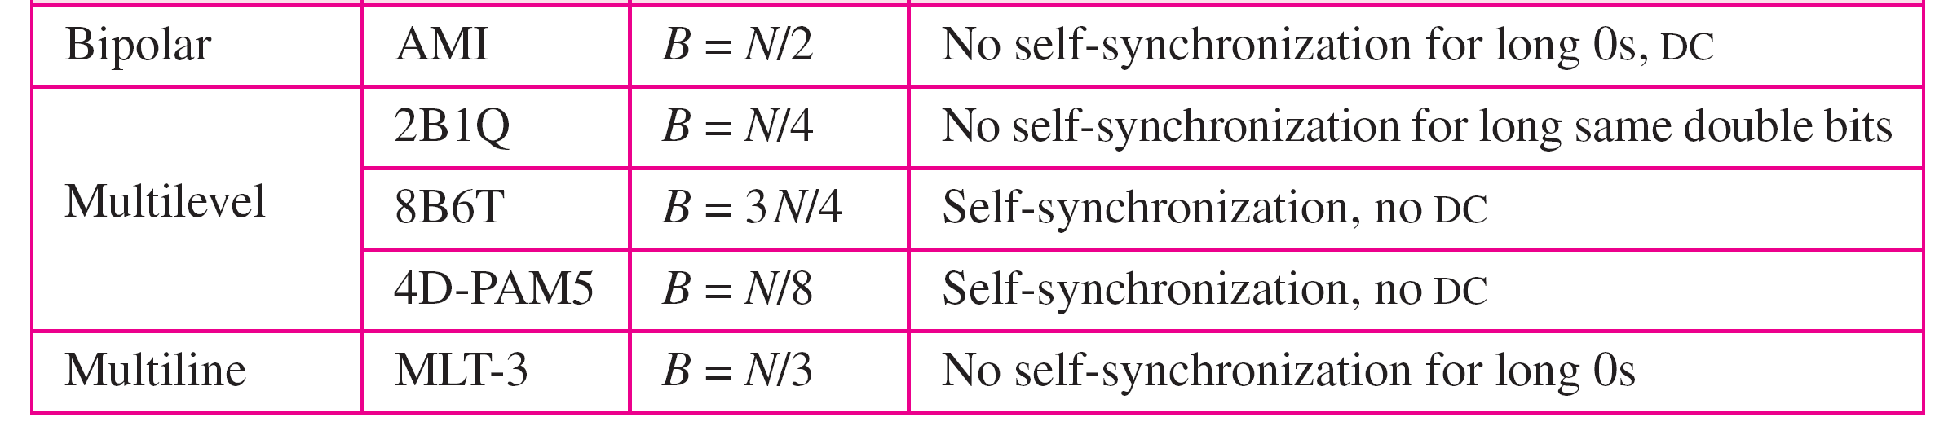
Table 4.1 Summary of line coding schemes

Slide 48
Block Codding

Slide 49
Note
Block coding is normally referred to as mB/nB coding;
it replaces each m-bit group with an n-bit group.

Slide 50
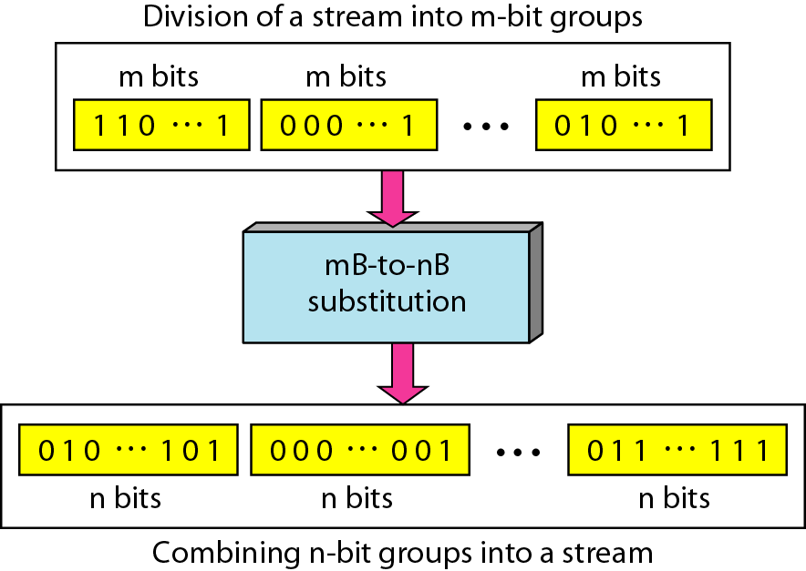
Figure 4.14 Block coding concept
STEP-1
STEP-2
STEP-3

Slide 51
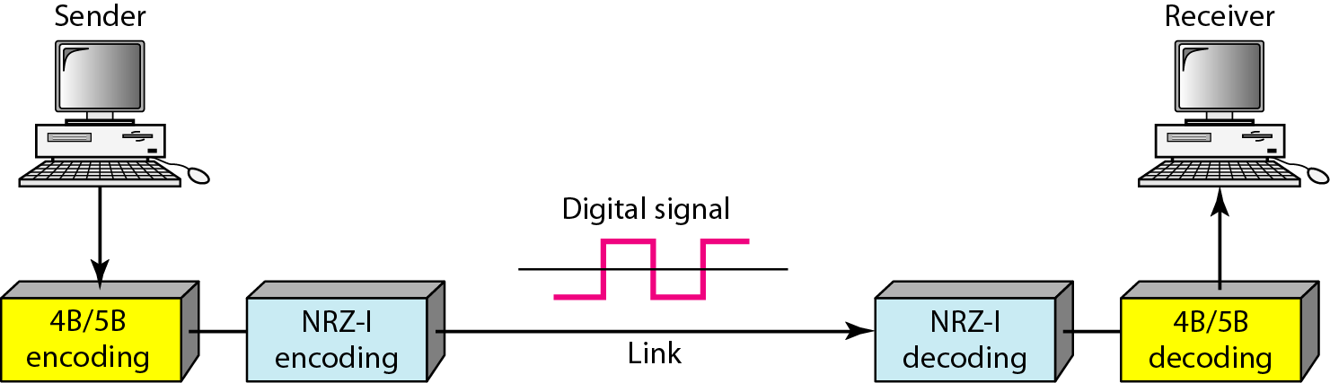
Figure 4.15 Using block coding 4B/5B with NRZ-I line coding scheme

Slide 52
4B/5B
The four binary/five binary (4B/5B) coding scheme was designed to be used in combination
with NRZ-I. (NRZ-I has a good signal rate, one-half that of the biphase, but it has a synchronization problem.)
The bit stream is changed, prior to encoding with NRZ-I, to avoid synchronization issues due to long sequence of 0s. The block-coded stream does not have more that three consecutive 0s.
At the receiver, the NRZ-I encoded digital signal is first decoded into a stream of bits and then decoded to remove the redundancy.
Figure 4.15 shows the idea. In 4B/5B, the 5-bit output that replaces the 4-bit input has no more than one leading zero (left bit) and no more than two trailing zeros (right bits). So when different groups are combined to make a new sequence, there are never more than three consecutive 0s.
Table 4.2 shows the corresponding pairs used in 4B/5B encoding. Note that the first two columns pair a 4-bit group with a 5-bit group.
A group of 4 bits can have only 16 different combinations while a group of 5 bits can have 32 different combinations. This means that there are 16 groups that are not used for 4B/5B encoding. Some of these unused groups are used for control purposes; the others are not used at all. The latter provide a kind of error detection.
If a 5-bit group arrives that belongs to the unused portion of the table, the receiver knows that there is an error in the transmission.

Slide 53
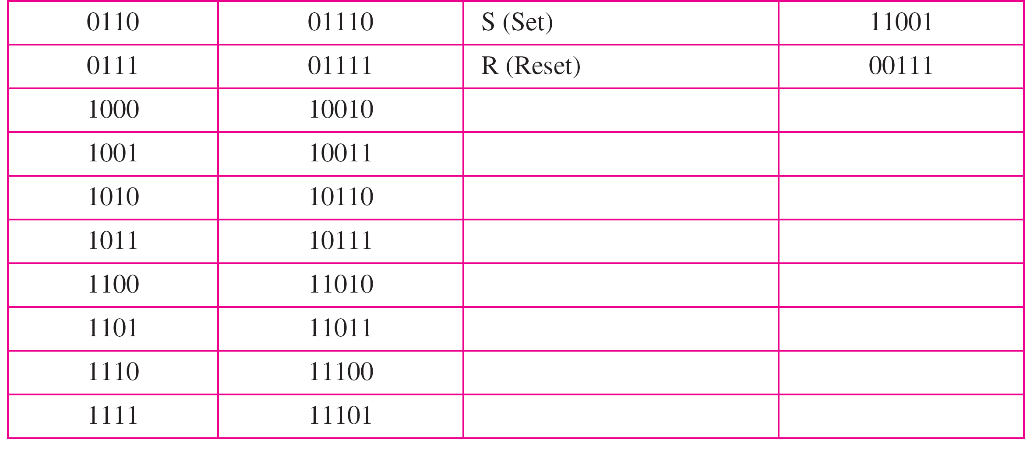
Table 4.2 4B/5B mapping codes

Slide 54
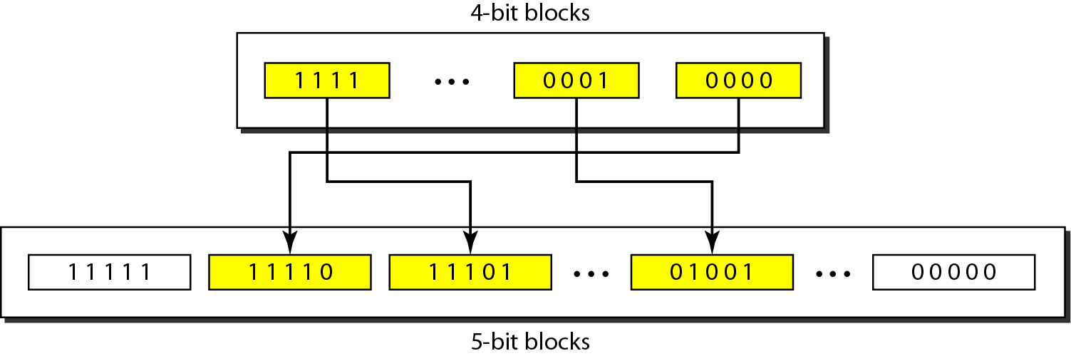
Figure 4.16 Substitution in 4B/5B block coding

Slide 55
The redundant bits add 20 percent more baud.
Still, the result is less than the biphase scheme which has a signal rate of 2 times that of NRZ-I.
However, 4B/5B block encoding does not solve the DC component problem of NRZ-I.
If a DC component is unacceptable, we need to use biphase or bipolar encoding.

Slide 56
8B/10B
The eight binary/ten binary (8B/10B) encoding is similar to 4B/5B encoding except that a group of 8 bits of data is now substituted by a 10-bit code.
The five most significant bits of a 10-bit block are fed into the 5B/6B encoder; the three least significant bits are fed into a 3B/4B encoder. The split is done to simplify the mapping table.
To prevent a long run of consecutive 0s or 1s, the code uses a disparity controller which keeps track of excess 0s over 1s (or 1s over 0s). If the bits in the current
block create a disparity that contributes to the previous disparity (either direction), then each bit in the code is complemented (a 0 is changed to a 1 and a 1 is changed to a 0).
The coding has 210 − 28 = 768 redundant groups that can be used for disparity checking and error detection. In general, the technique is superior to 4B/5B because of better built-in error-checking capability and better synchronization.

Slide 57
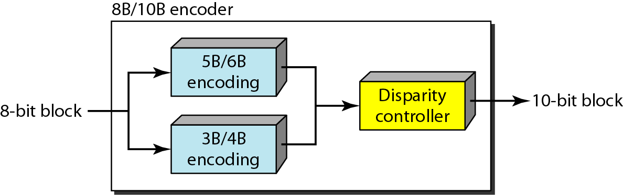
Figure 4.17 8B/10B block encoding

Slide 58
Scrambling

Slide 59
Scrambling
Scrambling is a solution that substitutes long zero-level pulses with a combination of other levels to provide synchronization.
A part of the AMI rule has been modified to include scrambling, as shown in Figure 4.18. Note that scrambling, as opposed to block coding, is done at the same time as encoding.
The system needs to insert the required pulses based on the defined scrambling rules.
Two common scrambling techniques are B8ZS and HDB3.

Slide 60
B8ZS
Bipolar with 8-zero substitution (B8ZS) is commonly used in North America.
In this technique, eight consecutive zero-level voltages are replaced by the sequence 000VB0VB. The V in the sequence denotes violation; this is a nonzero voltage that breaks an AMI rule of encoding (opposite polarity from the previous).
The B in the sequence denotes bipolar, which means a nonzero level voltage in accordance with the AMI rule.
The substitution may change the polarity of a 1 because, after the substitution, AMI needs to follow its rules.
The letter V (violation) or B (bipolar) here is relative. The V means the same polarity as the polarity of the previous nonzero pulse; B means the polarity opposite to the polarity of the previous nonzero pulse.

Slide 61
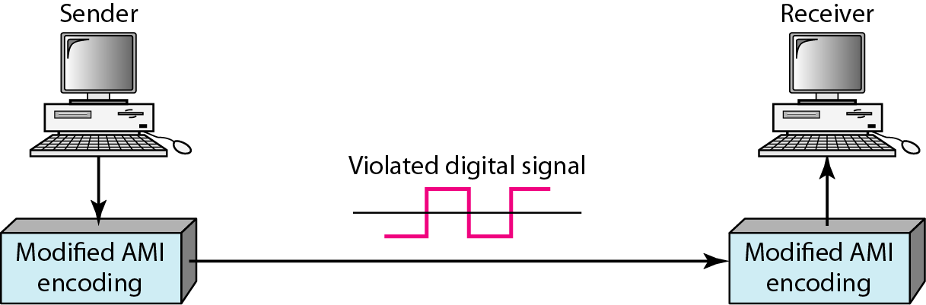
Figure 4.18 AMI used with scrambling

Slide 62
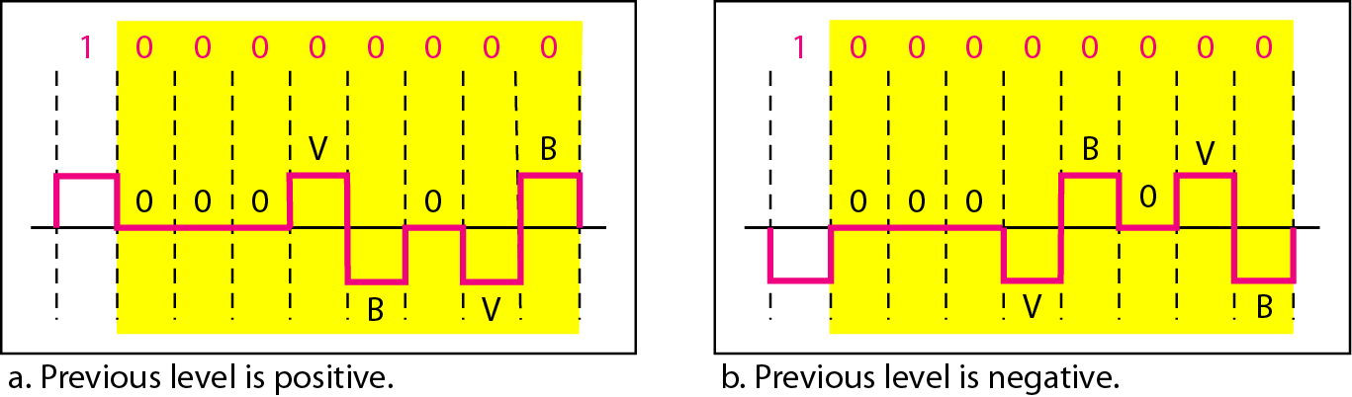
Figure 4.19 Two cases of B8ZS scrambling technique

Slide 63
HDB3
High-density bipolar 3-zero (HDB3) is commonly used outside of North America.
In this technique, which is more conservative than B8ZS, four consecutive zero-level voltages are replaced with a sequence of 000V or B00V.
The reason for two different substitutions is to maintain the even number of nonzero pulses after each substitution.
The two rules can be stated as follows:
1. If the number of nonzero pulses after the last substitution is odd, the substitution pattern will be 000V, which makes the total number of nonzero pulses even.
2. If the number of nonzero pulses after the last substitution is even, the substitution pattern will be B00V, which makes the total number of nonzero pulses even.
First, before the first substitution, the number of nonzero pulses is even, so the first substitution is B00V.
After this substitution, the polarity of the 1 bit is changed because the AMI scheme, after each substitution, must follow its own rule.
After this bit, we need another substitution, which is 000V because we have only one nonzero pulse (odd) after the last substitution.
The third substitution is B00V because there are no nonzero pulses after the second substitution (even).

Slide 64
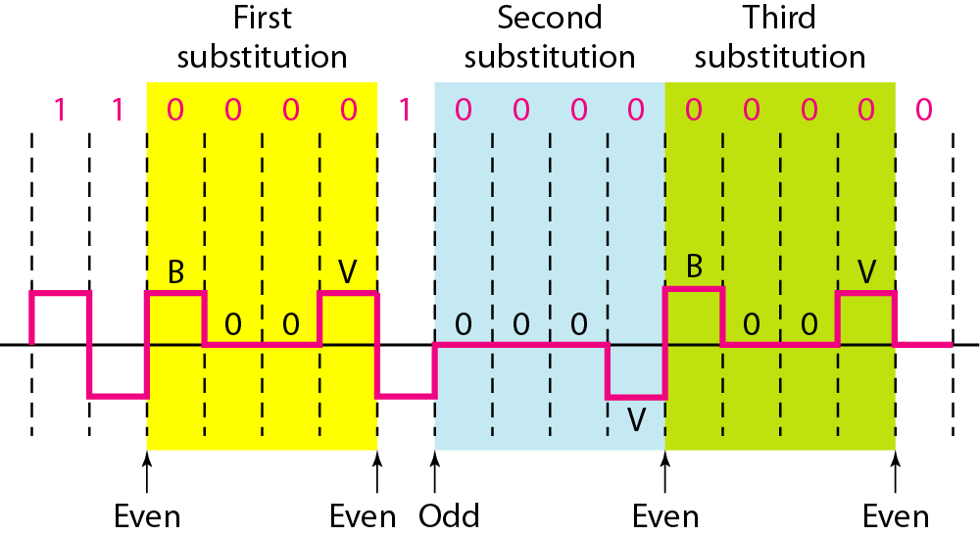
Figure 4.20 Different situations in HDB3 scrambling technique

Slide 65
What have we completed?
Thank You
Digital to Digital Conversion
Data Elements Vs Signal Elements
Data Rate Vs Signal Rate
Line codding schemes
Block codding schemes
Scrambling

